Slide 1
Pizza Sales Data Analysis Using Power BI & SQL
Here starts your presentation

Slide 2
The names of those who worked on the project:
أدهم محمود انور محمود 20240137
عابد احمد محمد فتحي 20241120
عبدالرحمن محمد امبابي حنفي 20241125
عبدالحميد هشام عبدالحميد 20242427
محمد حمدي عبدالفتاح 20242866

Slide 3
Content (Project Number 4)
Problem Statement
KPIs Requirements
Charts Requirements - Part 1
Charts Requirements - Part 2
Data → Information (KPIs Summary)
Information → Knowledge (Trends & Patterns)
Knowledge → Wisdom (Actionable Insights)
Recommendations

Slide 4
01
02
03
Data ➔ Information
Information ➔ Knowledge
Knowledge → Wisdom

Slide 5
Problem Statement

Slide 6
Business Need: Analyze pizza sales data to gain insights into performance Key Goal: Calculate KPIs and visualize trends for better decision-makingTotal Dataset Overview: Full-year sales data (e.g., thousands of orders)
Problem Statements

Slide 7
KPIs Requirements

Slide 8
Key Performance Indicators (KPIs)
Total Revenue
Sum of the total price of all pizza orders
Average Order Value
Total revenue divided by total number of orders
Total Pizzas Sold
Sum of quantities of all pizzas sold
Total Orders
Total number of orders placed
Average Pizzas Per Order
Total pizzas sold divided by total orders

Slide 9
Charts Requirements – Part 1

Slide 10
Charts Requirements – Part 1
Visualization Goals Daily Trend for Total Orders
Bar chart showing daily order volume
Hourly Trend for Total Orders
Line chart to identify peak hours
Percentage of Sales by Pizza Category
Pie chart showing category contribution

Slide 11
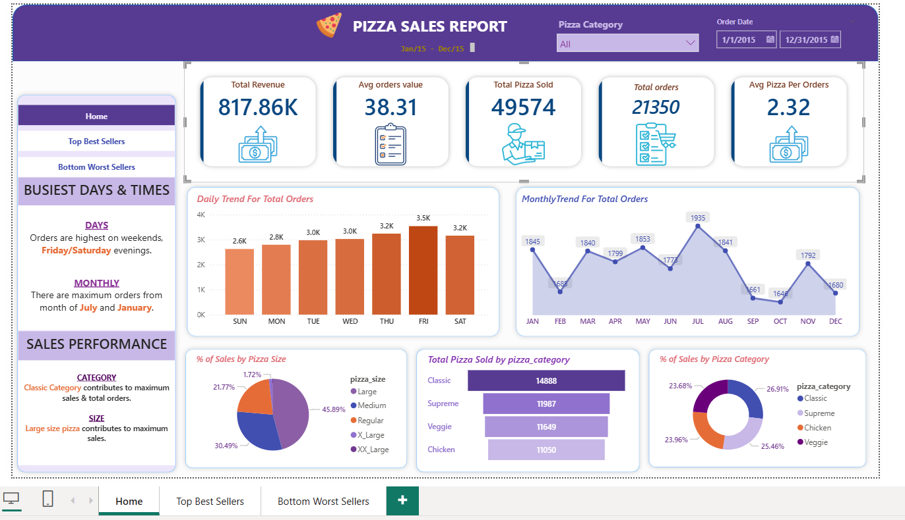

Slide 12
Charts Requirements – Part 2

Slide 13
Charts Requirements – Part 2
Percentage of Sales by Pizza Size
Pie chart for customer size preferences
Total Pizzas Sold by Pizza Category
Funnel/Bar chart for category comparisons
Top 5 Best Sellers
Bar chart by revenue, quantity, and orders
Bottom 5 Worst Sellers
Bar chart to identify underperforming items

Slide 14
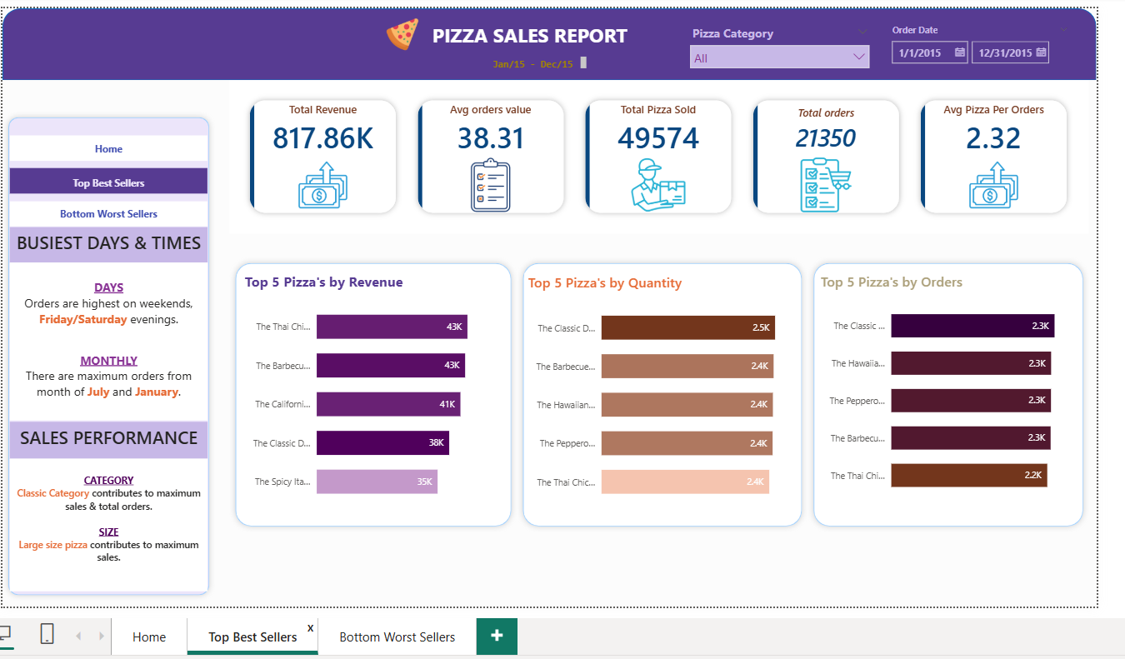

Slide 15
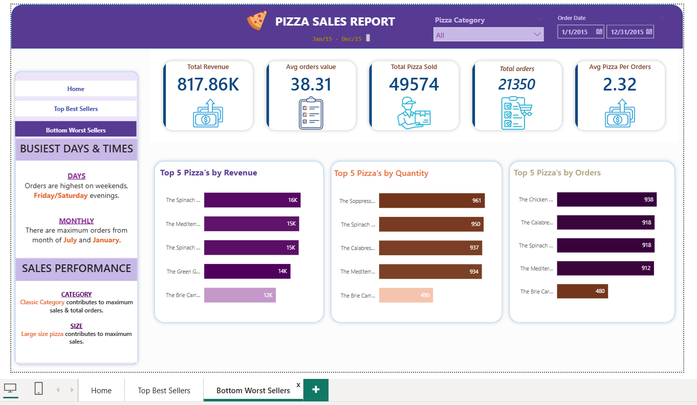

Slide 16
Data ➔ Information

Slide 17
Data ➔ Information
Raw Data
Individual order records (order ID, date, time, pizza name, size, category, price, quantity)
Transformation to Information
Aggregated raw data into meaningful KPIs
Cleaned and summarized sales metrics
Outcome
Clear view of overall performance (revenue, orders, units sold)

Slide 18
Information → Knowledge

Slide 19
Information → Knowledge
Key Insights from Data
Supreme category dominates sales
Large size pizzas preferred by customers
Orders peak during lunchtime
Multiple pizzas commonly ordered together
Clear distinction between top and bottom sellers

Slide 20
Knowledge → Wisdom

Slide 21
Knowledge → Wisdom
Actionable Business Recommendations
Promote Supreme and Large pizzas
Create lunch combo deals during peak hours
Bundle top-selling items to increase order value
Review or discount low-performing pizzas
Optimize staffing for lunchtime rush

Slide 22
Conclusion
Project Summary
Successfully converted raw sales data into business wisdom
Delivered KPIs and interactive visualizations
Provided data-driven recommendations
Value Delivered
Better understanding of customer behavior
Improved decision-making for menu, pricing, and operations

